Slide 1

Regression
Lecture 4
LSM3257
AY22/23; Sem 2 | Ian Z.W. Chan

Slide 2
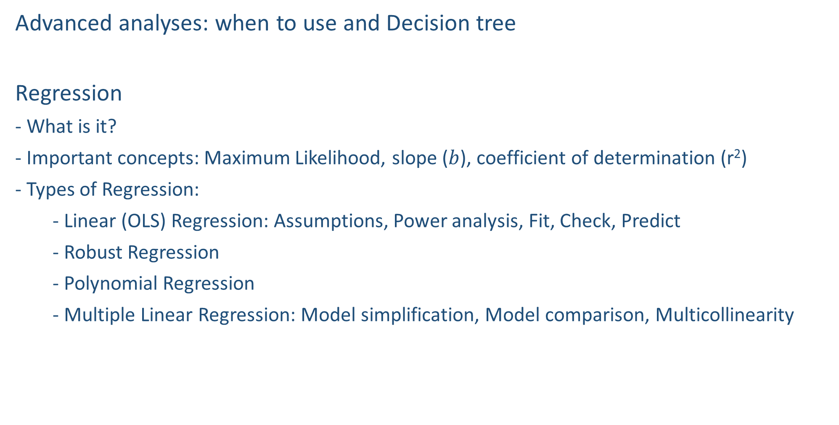
Summary (Learning Objectives)
Advanced analyses: when to use and Decision tree
Regression
- What is it?
- Important concepts: Maximum Likelihood, slope ($b$), coefficient of determination (r²)
- Types of Regression:
- Linear (OLS) Regression: Assumptions, Power analysis, Fit, Check, Predict
- Robust Regression
- Polynomial Regression
- Multiple Linear Regression: Model simplification, Model comparison, Multicollinearity

Slide 3
When to use more advanced analyses
Increasing altitude
Observational studies with many confounders
More complex relationships (e.g. non-linear)
Multiple explanatory variables (still one response variable)
Investigating cause-and-effect rather than correlation
- E.g. Pearson correlation vs. Regression
P
P
P
P
P
City
Human Disturbance
S
S
S
S
S
S
S

Slide 4
Advanced analyses – Analysis decision tree
(will be modified further)
Normally distributed (errors):
Regression
Not normally distributed (errors):
Generalised Linear Model (GLM) with an appropriate error structure
Start
All Continuous
Response variable type
Continuous
Explanatory variables types
All Categorical
Normally distributed (response):
Analysis of variance (ANOVA)
Not normally distributed (response):
Kruskal-Wallis test
Categorical
Continuous and Categorical
Time to Death
Count
Number of categories
Normally distributed (response):
Analysis of covariance (ANCOVA)
Not normally distributed (response):
Rank-based ANCOVA (RANCOVA) or
GLM with an appropriate error structure
Proportion
2
>2
GLM with Poisson errors (aka Poisson regression)
No
Overdispersion present?
GLM with Binomial errors (aka Binary Logistic regression)
Yes
Survival Analysis
GLM with Binomial errors (aka Logistic regression)
GLM with Quasi-Poisson errors or
GLM with Negative Binomial errors
GLM with Multinomial errors (aka Multinomial Logistic regression)

Slide 5
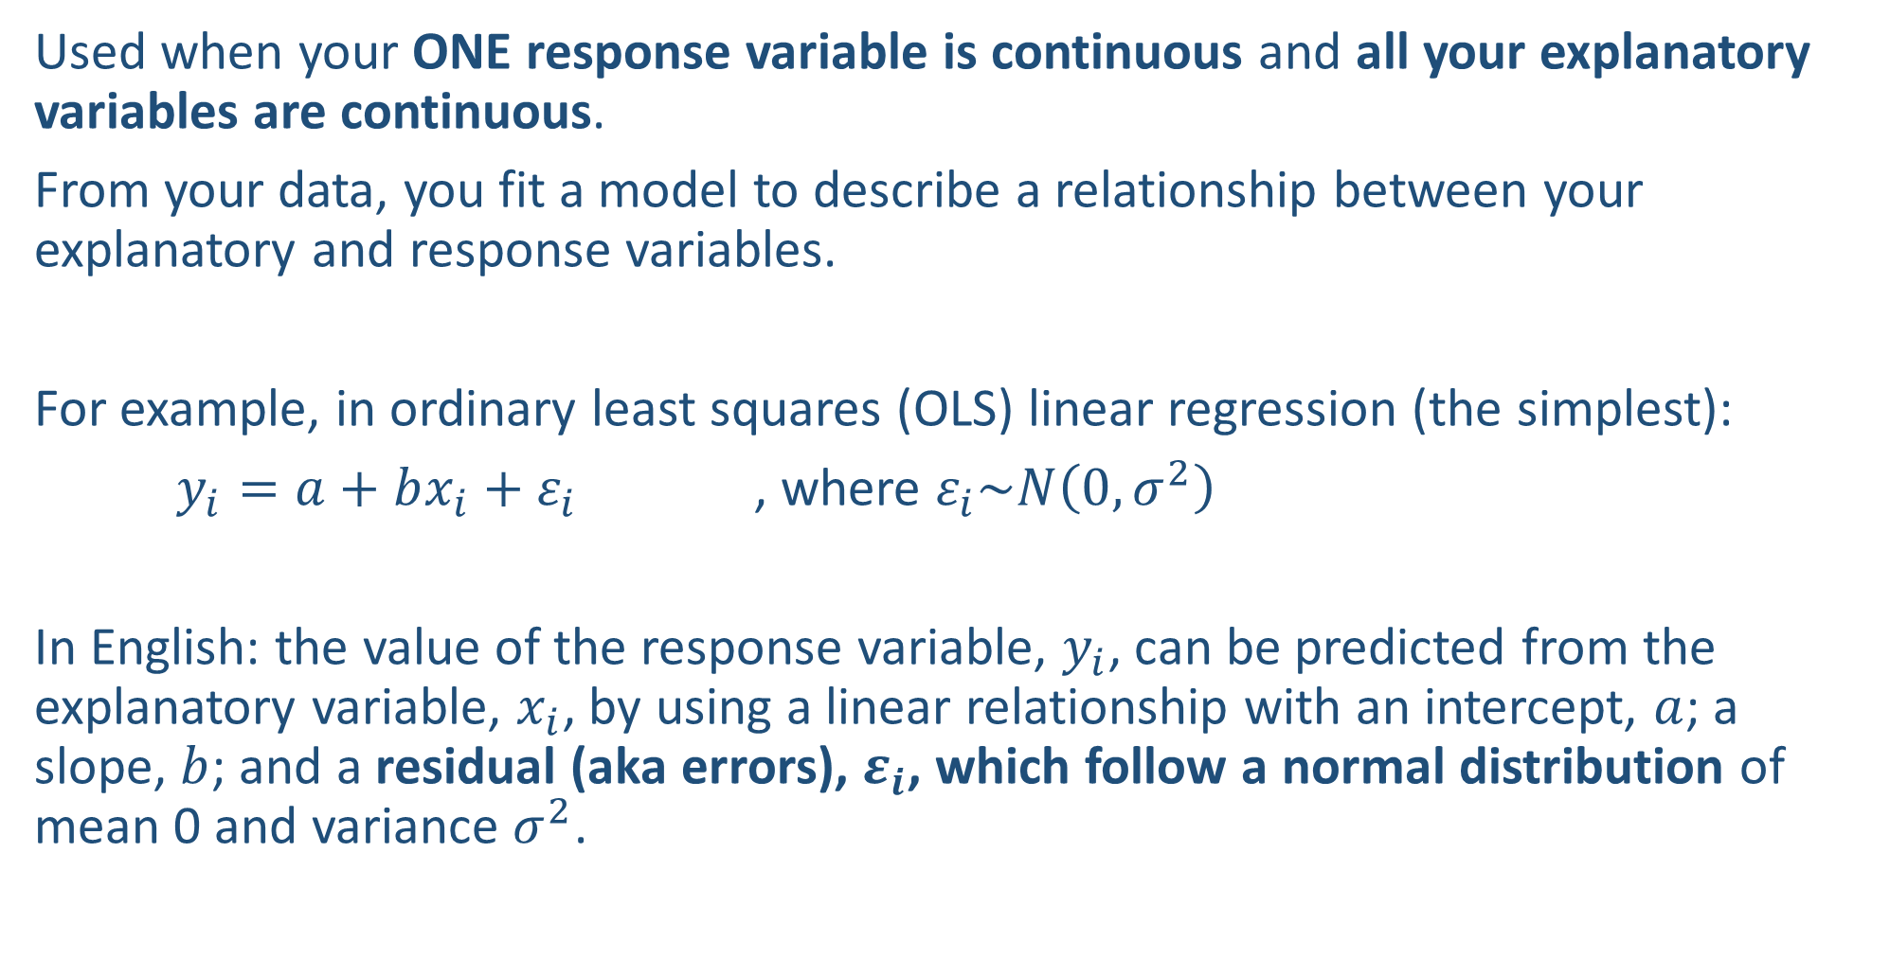
What is Regression?
Used when your ONE response variable is continuous and all your explanatory variables are continuous.
From your data, you fit a model to describe a relationship between your explanatory and response variables.
For example, in ordinary least squares (OLS) linear regression (the simplest):
$y_{i}=a+bx_{i}+ε_{i}$ , where $ε_{i}\sim N\left(0,σ^{2}\right)$
In English: the value of the response variable, $y_{i}$, can be predicted from the explanatory variable, $x_{i}$, by using a linear relationship with an intercept, $a$; a slope, $b$; and a residual (aka errors), $ε_{i}$, which follow a normal distribution of mean 0 and variance $σ^{2}$.

Slide 6
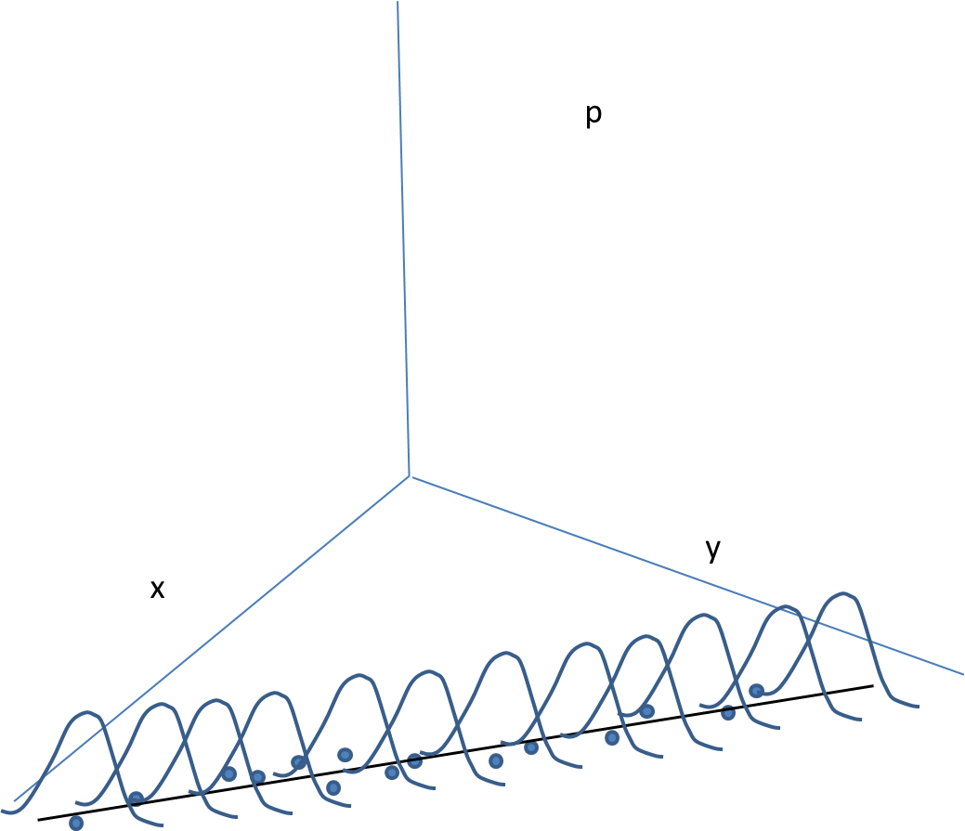
What is Regression?: A conceptual understanding
Diagrammatic representation of a linear regression:
p is the probability of observing other realisations of the data
Regression assumes the data come from these distributions
In reality, we only observe the blue points
Source: Roman Carrasco

Slide 7
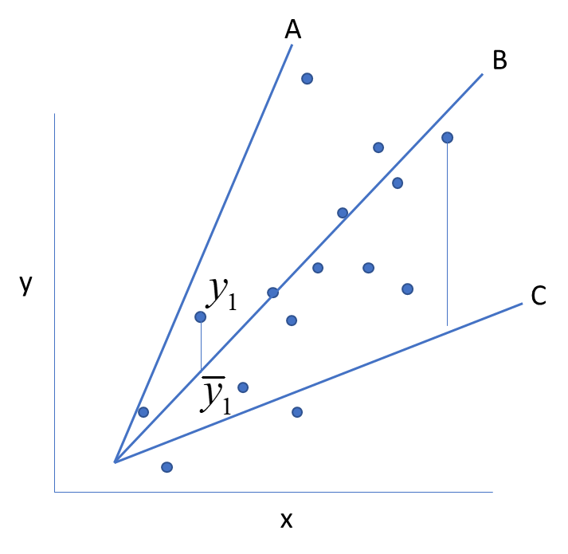
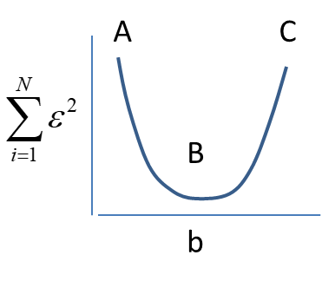
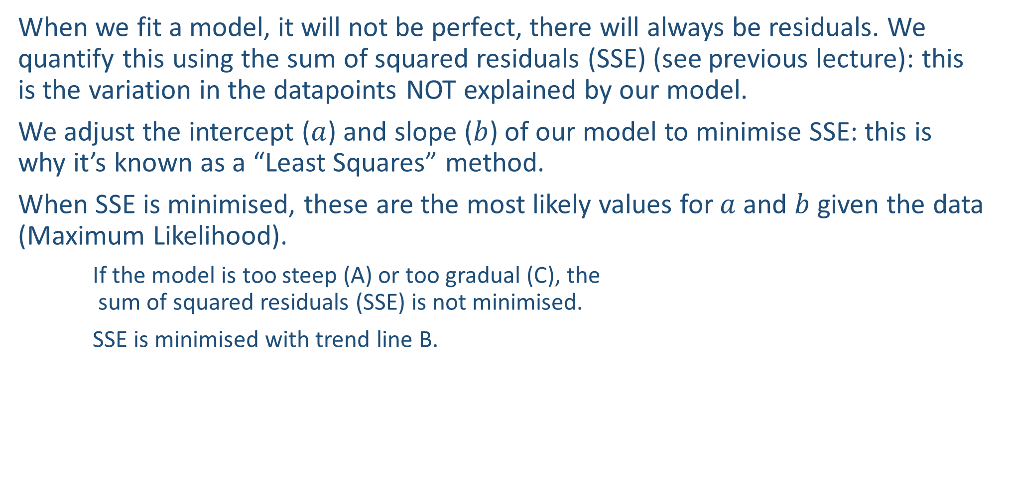
Maximum Likelihood
When we fit a model, it will not be perfect, there will always be residuals. We quantify this using the sum of squared residuals (SSE) (see previous lecture): this is the variation in the datapoints NOT explained by our model.
We adjust the intercept ($a$) and slope ($b$) of our model to minimise SSE: this is why it’s known as a “Least Squares” method.
When SSE is minimised, these are the most likely values for $a$and $b$given the data (Maximum Likelihood).
If the model is too steep (A) or too gradual (C), the sum of squared residuals (SSE) is not minimised.
SSE is minimised with trend line B.
SSE =

Slide 8

The slope: b
From the model, the most interesting parameter is $b$ (the slope) which tells us:
a) Whether there is a relationship between $x$ and $y$ (p-value), and
b) The strength/nature of this relationship (the steepness of the slope).
The intercept can potentially be interesting in some cases.
Example: the length of a particular bone ($y$) at birth when age ($x$) = 0.

Slide 9
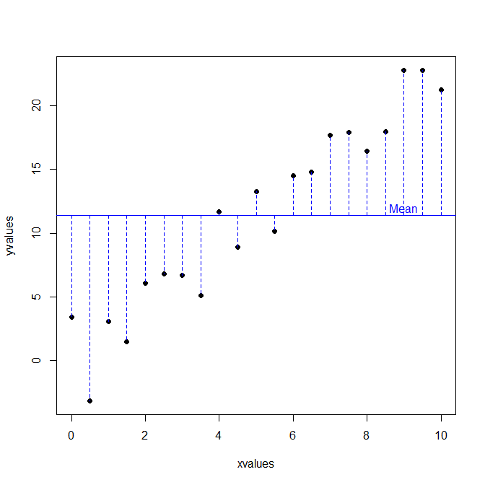
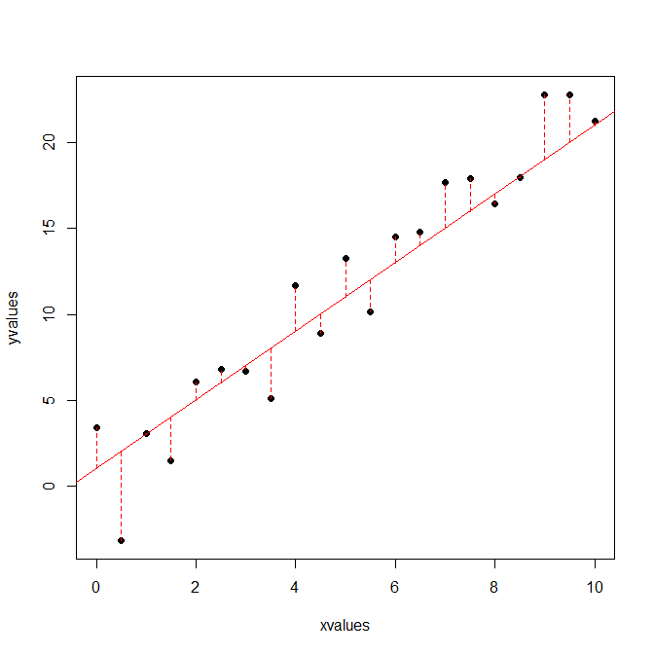

Coefficient of determination (r²)
The Coefficient of Determination (r²) is another statistic we are interested in.
SSY (or SST) is the original variation (total sum of squares).
SSE is the residual variation (not explained by the model).
SSR (the variation explained by the model) = SSY – SSE.
$r^{2}=\frac{SSR}{SSY}$, is the proportion of variation explained by the model (how well your explanatory variable predicts the response variable). Aka the goodness of fit.
$r$is the correlation coefficient.
SSE
SSY

Slide 10
Coefficient of determination (r²)
Be careful: r² is useful but it’s only part of the story.
A low r² value means we haven’t included important variables that would help us explain a larger share of the remaining variance.
- However, the variables we have studied could still explain a share of the variance and that can still be quite interesting.
A very high r² (e.g. a saturated model with r² = 1) fits all the datapoints perfectly but may have no explanatory power!
- r² will increase with every variable we add. We therefore do not decide whether to include a variable into a model based on increases in r². If we do, we will end up with a saturated model.
- Rather, we need to capture a balance between complexity and goodness of fit (e.g. using AIC or adjusted r² or an equivalent criteria).

Slide 11
Types of Regression
Linear regressions
Linear regression aka Ordinary Least Squares (OLS) regression: the most simple and frequently used.
Robust regression: this is a more modern (somewhat less established) technique that makes the fit less sensitive to outliers.
Polynomial regression: not so frequent, used to test for simple non-linearities in the relationship between variables.
Multiple regression: similar to linear regression but with multiple explanatory variables.
Note: these (together with ANOVA and ANCOVA) are all called “linear models” and can all be run using lm() in R (except for Robust regression).
More complex types not covered in this lecture
Piecewise regression: fitting 2 or more adjacent lines as opposed to 1 line throughout.
Non-linear regression: fitting complex curves to the data.

Slide 12
Linear (OLS) Regression

Slide 13
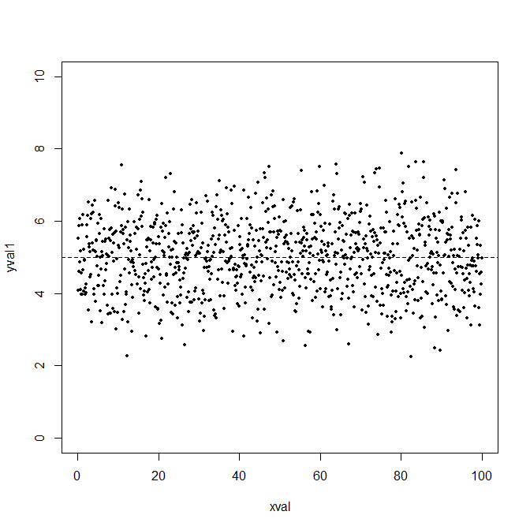
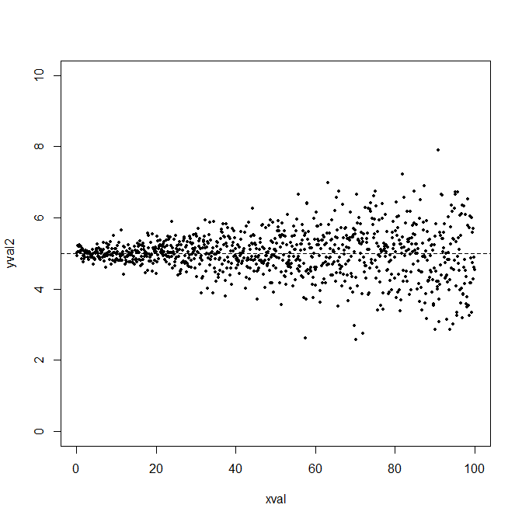
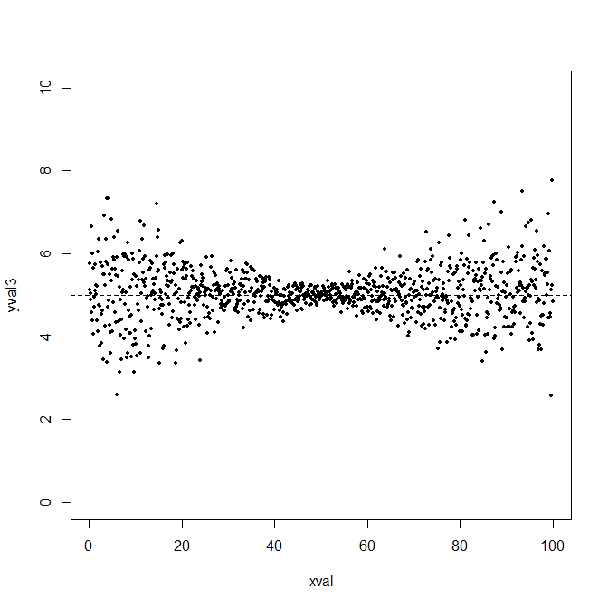
Assumptions
1) Homoscedasticity: variance of y is constant through all values of x or y.
2) For each x value, the values of y come from a normal distribution: i.e. the errors aka residuals (in SSE) are normally distributed.
3) The samples are independent from one another.
4) The relationship between y and x is linear.
Note: Biological data are very messy and tend to violate these assumptions and therefore more sophisticated analysis techniques are needed (covered in later lectures)—but regression is the foundation!
Heteroscedasticity

Slide 14
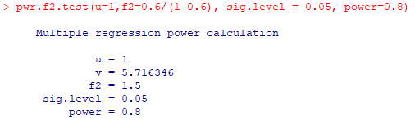
Power analysis (also applicable to the other types of regression covered)
#Install and load pwr package
#Code expected: pwr.f2.test(u = ?, f2 = ?, sig.level = 0.05, power=0.8)
pwr.f2.test(u=1,f2=0.6/(1-0.6), sig.level = 0.05, power=0.8)
#Calculate sample size needed, n = u + 1 + v (from the output) = 1 + 1 + 5.7 ≈ 8
u = number of coefficients in the model minus one; for 𝑦_{𝑖}=𝑎+𝑏𝑥_{𝑖}, there are 2 coefficients (𝑎 and 𝑏), so u = 1
f2 = r²/(1-r²); you have to decide your r² based on pilot studies or "approximation" (e.g. 0.5 means your model will explain 50% of all variation; a good range is 0.4-0.7); for this example, I choose 0.6

Slide 15
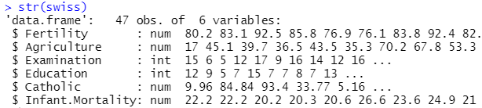
Fitting a model
#Inspect our dataset to see variable names
str(swiss)
Research Question: do fertility rates explain infant mortality?
#Model formula
mod1=lm(Infant.Mortality~Fertility,data=swiss)
This also works to fit the model:
mod1=lm(swiss$Infant.Mortality~ swiss$Fertility)
But it is not recommended because predict() will not work.
Save your model to this object
The formula
Your dataset
mod1=lm(Infant.Mortality~Fertility, data=swiss)
Function to fit a linear model (including a linear regression)
Response variable (the y in the equation)
Explanatory variable (the x in the equation)

Slide 16
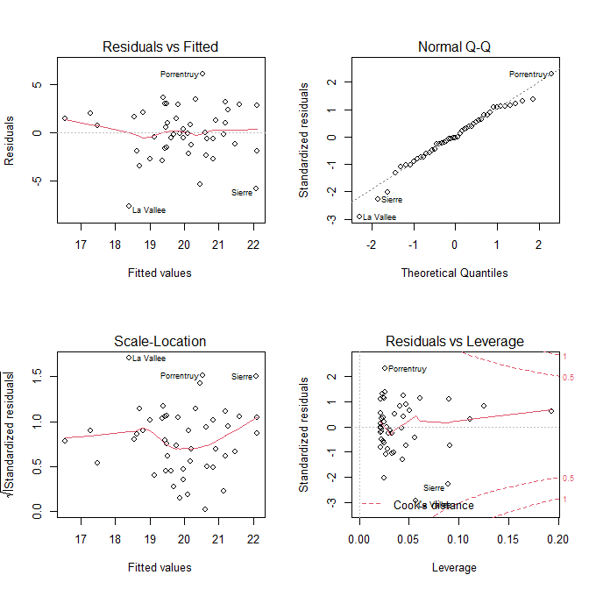
Checking assumptions
Inspecting for normality of errors
Should be along the diagonal dotted line.
This looks reasonable.
Any banana or s-shape is bad.
Can also test using:
shapiro.test(resid(mod1)).
#Diagnostic plots
par(mfrow=c(2,2))
plot(mod1)
Inspecting for homoscedasticity
- Both should look like “stars in the sky” (i.e. no patterns): red line about horizontal and spread around the red line stays relatively constant. Cone-, banana- or s-shape is bad.
- The Scale-Location plot is better when there are more values on one side of the x-axis.
- Top looks good; bottom looks marginal but still OK.
- There are some tests we can use: (a) bptest(mod1) from the “lmtest” package; (b) ncvTest(mod1) from the “car” package. But they tend to be problematic! So I use these plots.
Inspecting for outliers
Should be no points outside the 0.5 or 1 dotted line.
This looks good.
Points outside the lines represent extreme datapoints against a regression line (they have a large effect on the regression results).

Slide 17
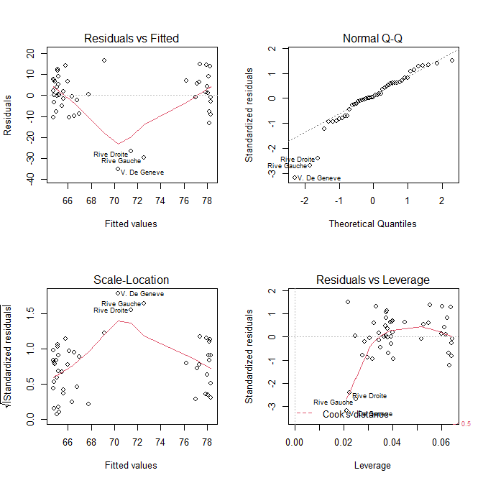
Checking assumptions – negative example
Inspecting for normality of errors
Values at bottom left are a little too far below the diagonal for comfort.
Inspecting for homoscedasticity
Bad—there is a clear pattern. There may be something else that needs to be accounted for, perhaps another interacting variable.
Inspecting for outliers
Looks good—no outliers.

Slide 18
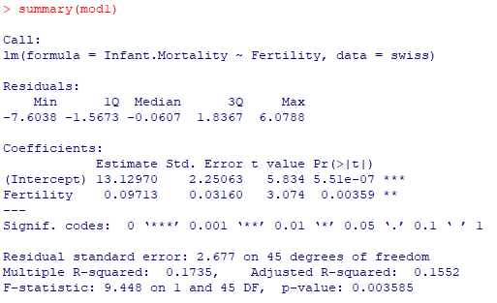
Interpreting the model
Model that was run
#Call a summary()
summary(mod1)
Distribution of residuals
The intercept is not so interesting for our purposes this time
Whether the relationship is significant: Yes—Fertility predicts Infant Mortality!
Coefficient (b) value for the Fertility variable (with uncertainty estimate): for every increase of Fertility by 1, Infant.Mortality increases by 0.97 ± 0.032
Our variable accounts for only 17% of the variance but its effect is still significant
RSE, a measure of how much variation remains unexplained: square root of (SSE divided by df)
Adjusted R² tries to account for the number of variables in your model. Use “Multiple R-squared” if you have one explanatory variable and “Adjusted R-squared if you have more than one.
From an ANOVA table (next slide)

Slide 19
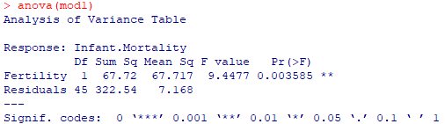
Interpreting the model
#Or call an ANOVA table (don’t be confused by the name this is NOT doing an ANOVA)
anova(mod1)
Note: the “summary” and “anova” output show similar data, but “summary” is formatted to identify relationships between the variables; whereas “anova” is formatted to show how much variation is explained by each variable.
Amount of variation explained by your model
F statistic (from tables) used to calculate the p-value
Whether your model explains significantly more variation than a null model
Amount of unexplained variation remaining (in the residuals)
RSE² (RSE from the previous slide)

Slide 20
Interpreting the model
Remember our research Question: do fertility rates explain infant mortality?
Reporting that <Fertility> rates predict <Infant.mortality>:
“Fertility rates have a significant effect on infant mortality (P = 0.004). An increase of 1 in the fertility rate results in an increase in infant mortality of 0.097 ± 0.031 (mean ± SE).”
Reporting on how important a predictor <Fertility> is:
“Fertility rates account for 17.4% of the variation in infant mortality.”
Note: 67.72/(67.72+322.54) = 0.1735

Slide 21
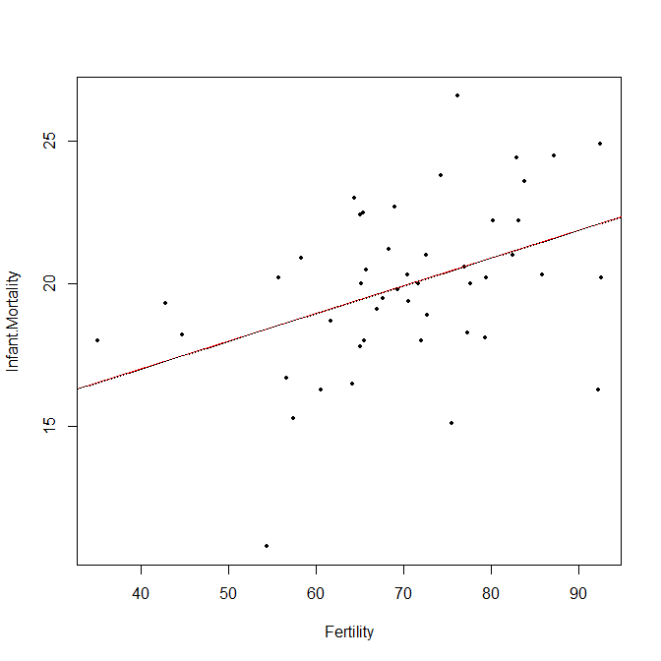
Visualising and Predicting using the model
#Scatterplot with linear trendline from model
plot(Infant.Mortality~Fertility,data=swiss, pch=16,cex=0.5)
abline(lm(Infant.Mortality~Fertility,data= swiss),col="red")
#Predict y-values for any x-value (remember it assumes a LINEAR relationship)
predict(mod1,list(Fertility=c(2,65,140)))
#Can be used to plot the line manually
lines(seq(30,100,0.01),predict(mod1, list(Fertility=seq(30,100,0.01))),lty=9)
This plots the typical linear model (for Base R)

Slide 22
What if my response variable shows heteroscedasticity?
Option 1: Transform your variables
Try to apply one of these functions to your y-variable and try again: log(), sqrt(), or cube root “x^(1/3)”
If it works, great! But be careful how you write up your report…
If it doesn’t work …
Option 2: Use GLS (later lecture)
Next section: Robust Regression!
What if my response variable has influential observations/outliers?

Slide 23
Robust Regression

Slide 24
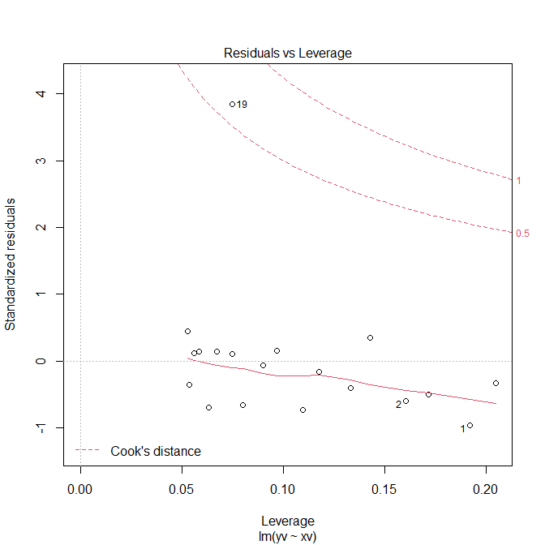
Dealing with outliers/influential observations
Diagnostic Plot 4 (Bottom Right)
#Create dataset and model
d2=read.table("diminish.txt",header=T)
plot(yv~xv,data=d2)
mod2=lm(yv~xv,data=d2) #check plots
Option 1: Identify and remove the outlier(s) manually (typical cut-off value is Cook’s Distance > 4/n).
which(cooks.distance(mod2)>4/nrow(d2)) #19
d3=d2[-19,] #remove row manually
Option 2: Run Robust Regression (if you cannot remove the point; decreases weightage of outliers in the regression).
#Install MASS package
mod2r=rlm(yv~xv,data=d2)
summary(mod2r) #t-value=9.1505, df=17
#have to calculate p-value manually
2*pt(9.1505,17,lower=F)
Influential datapoint:
Go back and check the dataset

Slide 25
What if my residuals are not normally distributed?
Option 1: Transform your response variable
Try to apply one of these functions to your y-variable and try again: log(), sqrt(), or cube root “x^(1/3)”
If it works, great! But be careful how you write up your report…
If it doesn’t work …
Option 2: Use a GLM (later lectures)
Next section: Polynomial Regression!
What if the relationship looks slightly non-linear?

Slide 26
Polynomial Regression

Slide 27
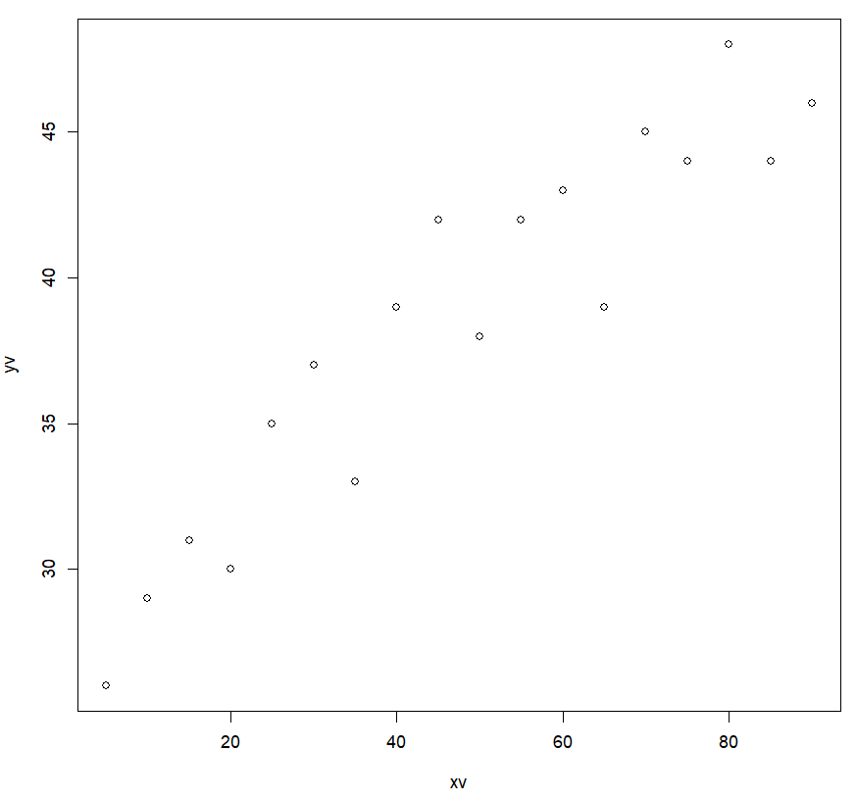
Polynomial but linear!
Used to model very simple curved relationships, e.g. square (second order power). It is rare (and frowned upon by reviewers) to use higher order powers.
Even though we square the explanatory variable, the parameters are still linear, i.e. the form is still a linear equation: y = a + b(x²).
#Plot <d3> from the previous section
plot(yv~xv,data=d3)
#What do you think: linear or curved?
#Fit a linear and a quadratic (2nd order) model to compare
linMod3=lm(yv~xv,data=d3)
quadMod3=lm(yv~I(xv^2)+xv,data=d3)
Also include the first order variable
Add a “^2” to your x-variable, and put an “I( )” around it

Slide 28
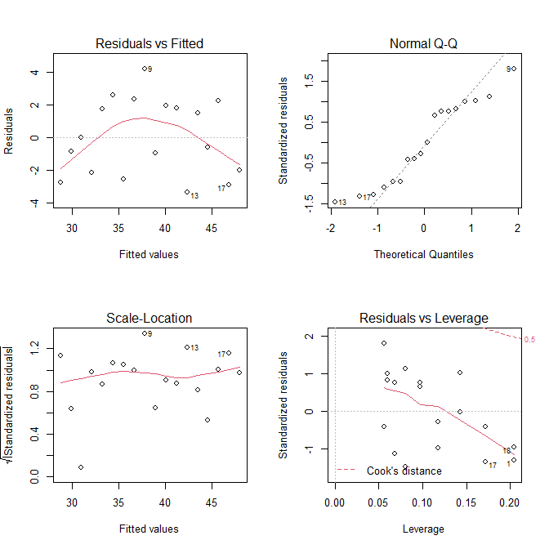
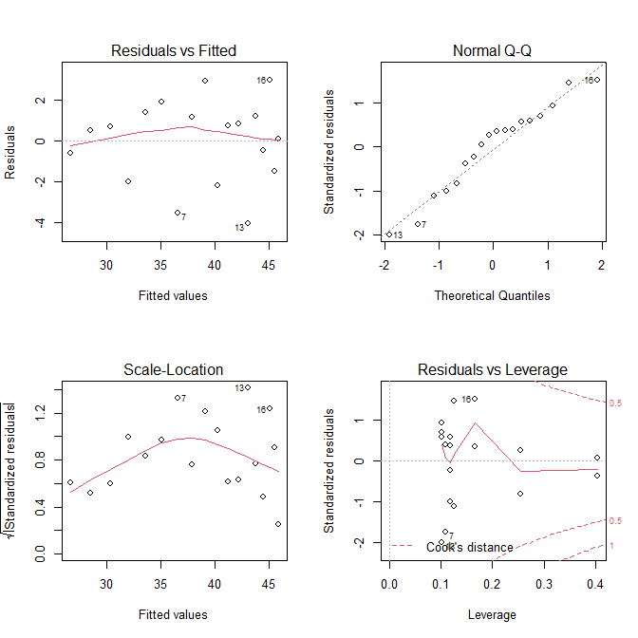
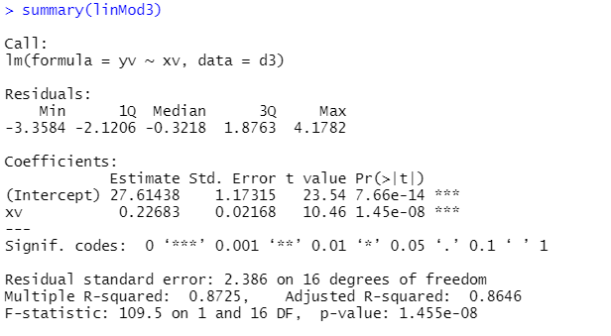
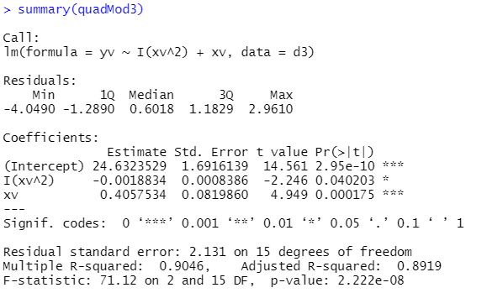
Linear vs Quadratic model
Linear
Quadratic
#Check both models
par(mfrow=c(2,2))
plot(linMod3)
plot(quadMod3)
#What do you notice?
#Get results
summary(linMod3)
summary(quadMod3)
#All coefficients in both models are significant!
#How to decide?
Quadratic model explains more variation (smaller residual) BUT uses up more df
Can compare using Adjusted R-squared

Slide 29
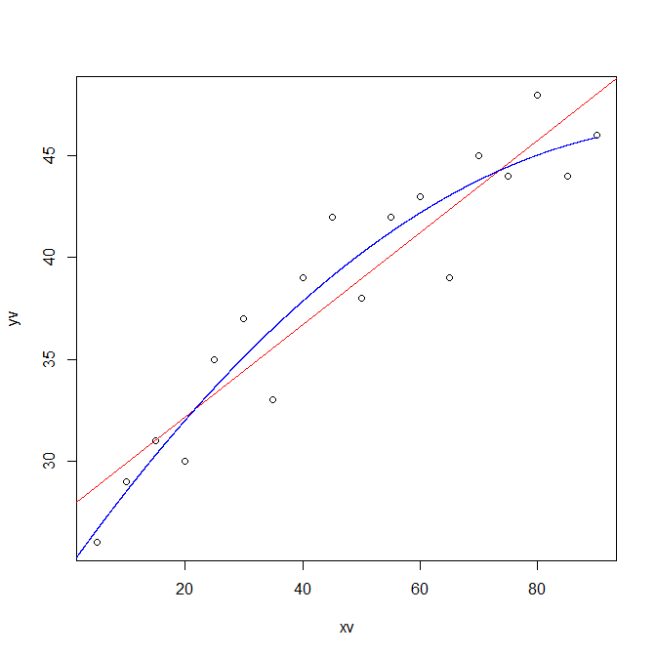
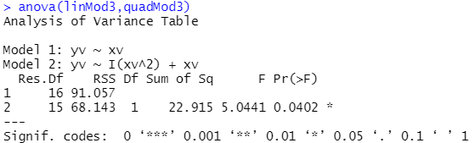
Linear vs Quadratic model
#Also can compare visually
plot(yv~xv,data=d3)
abline(lm(yv~xv,data=d3),col="red")
lines(seq(0,90,0.01),predict(quadMod3, list(xv=seq(0,90,0.01))),col="blue")
#Or compare directly using an F test via the anova() function
anova(linMod3,quadMod3)
Note: Based on whether you input one or two models into the anova() function, it is smart enough to know what you want it to do.
Linear
Quadratic
The quadratic model has significantly lower RSS (SSE) and is thus better

Slide 30
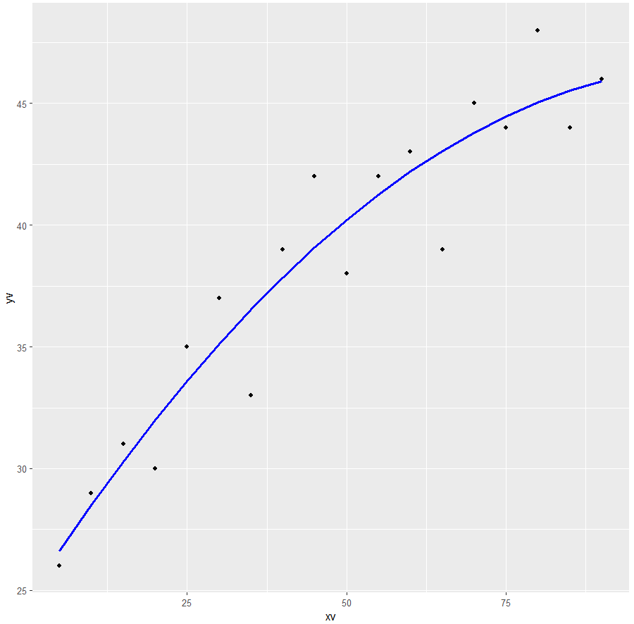
Interpreting the model
Can also plot using ggplot:
d3$y2v=predict(quadMod3)
ggplot(d3,aes(x=xv,y=yv))+geom_point()+
geom_line(aes(x=xv,y=y2v),col="blue",size=1)
“Within the range of 0 to 100 units, an increase in xv results in an increase in yv (p-value < 0.001) which slows by 0.0019 units for each unit of xv (p-value = 0.04).”
If effect size is not important, you can just report the pattern and leave out the numbers: “an increase in yv that tapers off”.
At xv=0, the slope is 0.41: i.e. a 1 unit increase in xv results in a 0.41 units increase in yv. This increase slows by 0.0019 units for each unit of xv. At xv=1, the slope becomes 0.41-0.0019=0.4081.
In real life don’t just say “units”, use the unit of the actual variable, e.g. “km”, “ppm”, “m/s”

Slide 31
What if I have more than one explanatory variable?
Multiple regression!!

Slide 32
Multiple Linear Regression

Slide 33
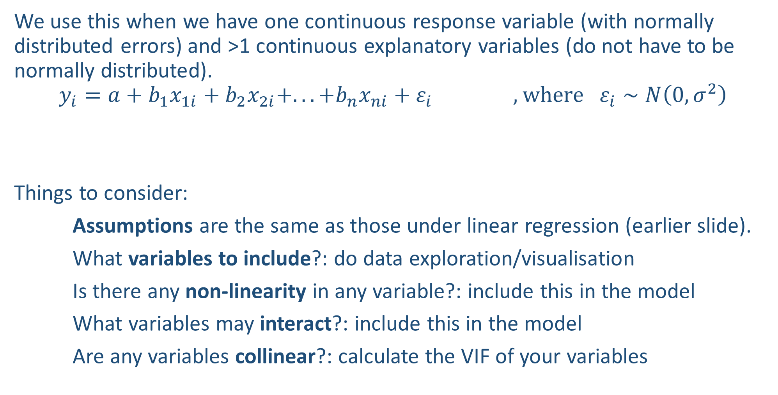
Fitting a multiple regression
We use this when we have one continuous response variable (with normally distributed errors) and >1 continuous explanatory variables (do not have to be normally distributed).
$$y_{i}=a+b_{1}x_{1i}+b_{2}x_{2i}+...+b_{n}x_{ni}+ε_{i} \text{ , }\text{where} ε_{i}∼N\left(0,σ^{2}\right)$$
Things to consider:
Assumptions are the same as those under linear regression (earlier slide).
What variables to include?: do data exploration/visualisation
Is there any non-linearity in any variable?: include this in the model
What variables may interact?: include this in the model
Are any variables collinear?: calculate the VIF of your variables
Linear predictor

Slide 34
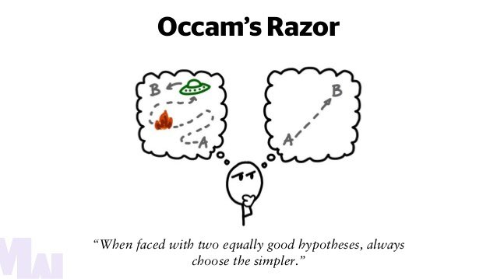

Simplifying and Choosing the right model
We start with many different variables, then we try to remove non-significant variables (i.e. those that do not help the model explain significantly more variance) and finally choose the simplest model possible (Occam’s razor).
We aim to achieve the minimum adequate model.
Source: https://tomasvotruba.com/blog/2020/03/09/art-of-letting-go/

Slide 35
Simplifying and Choosing the right model
Two approaches:
1) Stepwise deletion approach (Traditional approach and still widely used).
Start with a maximal model (with many variables and interactions, within reason) and simplify to a minimum adequate model (principle of parsimony).
We remove the most complicated elements first, one by one, in the following order:
1) Non-significant interaction terms*.
2) Non-significant quadratic/non-linear terms*.
3) Non-significant explanatory variables*. (note: if a non-significant variable has a significant interaction, you CANNOT remove it).
*Highest p-value first
2) Information-theoretic approach.
Fit biologically-sound candidate models (based on existing knowledge) and choose the best model or set of models (and average them if more than one model is chosen).

Slide 36
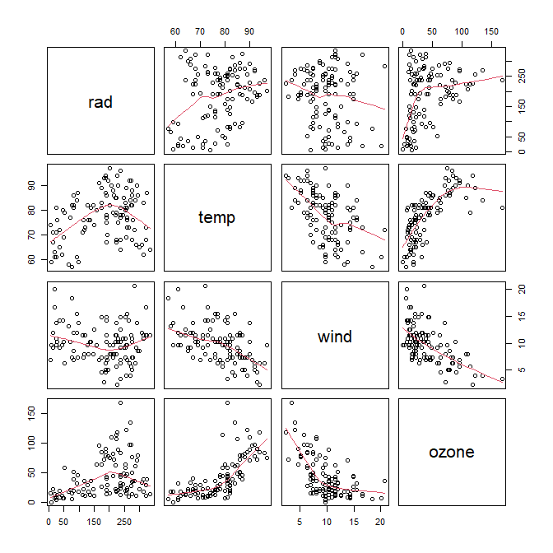
Stepwise deletion approach - data exploration/visualisation
Example using the ozone dataset
We want to look at the effects of solar radiation (rad), temperature (temp) and wind speed (wind) on ozone concentration (ozone).
#Read in the dataset and visualise for relationships
d5=read.table("ozone.data.txt",header=T)
pairs(d5,panel=panel.smooth)
Looks like all 3 may affect <ozone> and there may be non-linearity
Adds the red lines in the plot
Unclear, maybe humped (curved) relationship?
Positive correlation, may be curved
Negative correlation, may be curved
36

Slide 37
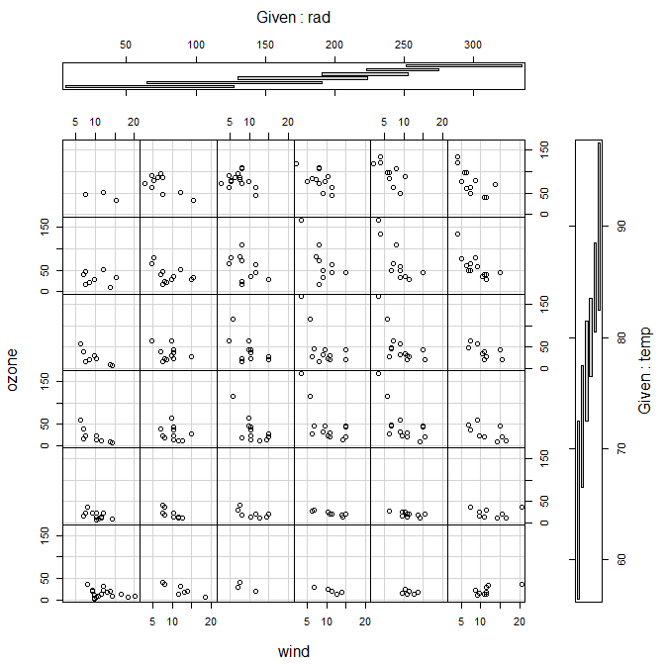
Stepwise deletion approach - data exploration/visualisation
#Use coplot() to look for interactions between explanatory variables
coplot(ozone~wind|rad*temp,data=d5)
There may be an interaction: the relationship between ozone and wind seems to become more negative when both rad and temp increase (see red lines)
#If only splitting one variable on the horizontal axis, add a row=1
coplot(ozone~wind|rad,data=d5,row=1)
Main variables
Split into different levels on the horizontal axis
Split into different levels on the vertical axis

Slide 38
Stepwise deletion approach – fitting the maximal model
Note: Model formulae
y~x1+x2 (no interaction, only the individual effects of x1 and x2 are tested)
y~x1:x2 (interaction ONLY, the individual effects are not tested)
y~x1*x2 (individual effects AND interaction are tested, i.e. x1+x2+x1:x2)
Based on our plot, we decide to fit a model testing…
(this is a very complicated model, try not to do this in real life)
a) all the variables,
b) the interactions between all of them, and
c) for possible curvature.
Fitting the model:
mod5.1<-lm(ozone~temp*wind*rad+I(rad^2)+I(temp^2)+I(wind^2),data=d5)
The first order (i.e. non-quadratic) terms are already included in here

Slide 39
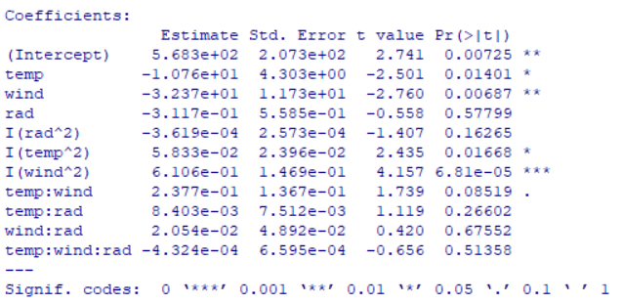
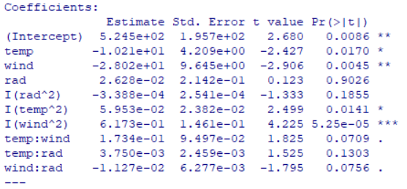
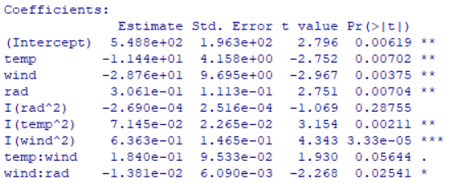
Stepwise deletion approach – simplification
mod5.1
#Let’s inspect the results
summary(mod5.1)
#Look at the most complicated term first, the 3-way interaction (temp:wind:rad). It is clearly not significant, so we remove it
mod5.2=update(mod5.1,~.-temp:wind:rad)
summary(mod5.2)
#Next we look at the 2-way interactions and remove temp:rad first
mod5.3=update(mod5.2,~.-temp:rad)
summary(mod5.3)
mod5.2
This period means everything in <mod5.1>
Minus only this 3-way interaction (the individual variables are kept)
mod5.3

Slide 40
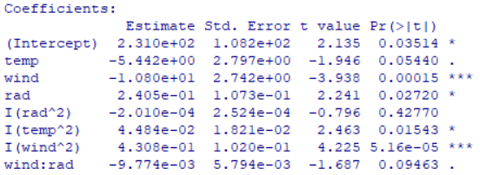
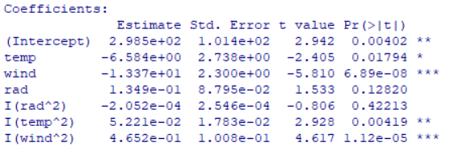
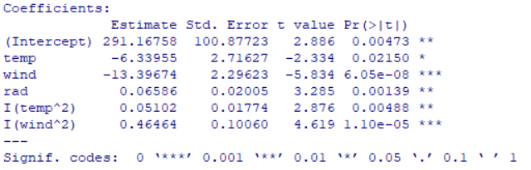
Stepwise deletion approach – simplification
mod5.4
#Then we remove temp:wind (note here that wind:rad looks significant)
mod5.4=update(mod5.3,~.-temp:wind)
summary(mod5.4)
#With temp:wind gone, wind:rad is no longer significant so we remove it too
mod5.5=update(mod5.4,~.-wind:rad)
summary(mod5.5)
#Next, the non-linear terms; remove rad^2
mod5.6=update(mod5.5,~.-I(rad^2))
summary(mod5.6)
#Everything is significant; nothing can be removed: we have reached our ”minimum adequate model”
mod5.5
mod5.6

Slide 41
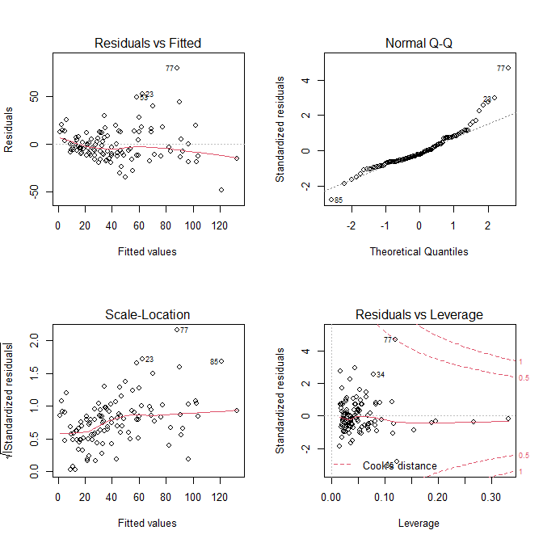
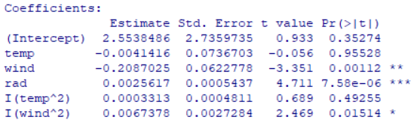
Stepwise deletion approach – model checking
#But don’t forget to check the model!: Diagnostic plots
par(mfrow=c(2,2))
plot(mod5.6)
#Problems with heteroscedasticity and normality, so we cannot trust the results. Let’s try a log transform:
mod5.7=lm(log(ozone)~temp+wind+rad+I(temp^2)+ I(wind^2),data = d5)
summary(mod5.7)
#After the log transform, it looks like temp^2 is no longer significant, so we remove it
mod5.7

Slide 42
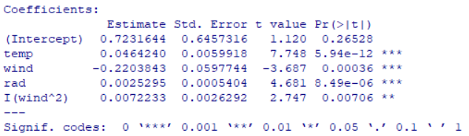
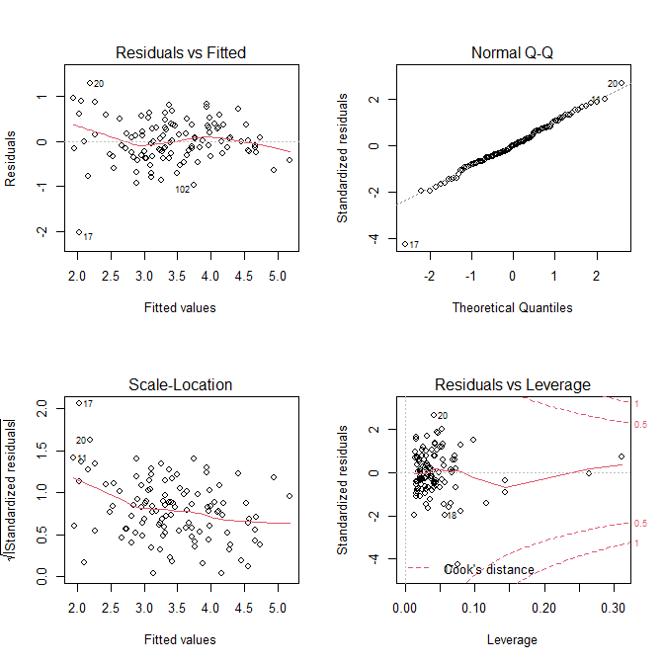
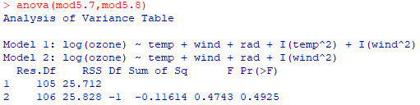
Stepwise deletion approach – model checking
mod5.8
#Remove temp^2
mod5.8=update(mod5.7,~.-I(temp^2))
summary(mod5.8) #Everything is significant
#Compare the last 2 models
anova(mod5.7,mod5.8)
#This is a minimum adequate model, let’s check the assumptions again
par(mfrow=c(2,2))
plot(mod5.8)
#Scedasticity and normality look better but still a bit iffy: but notice that in both cases observation 17 is the problem!
mod5.8 explains less variation, but not significantly less, so we therefore prefer the simpler model: mod5.8.
Answer

Slide 43
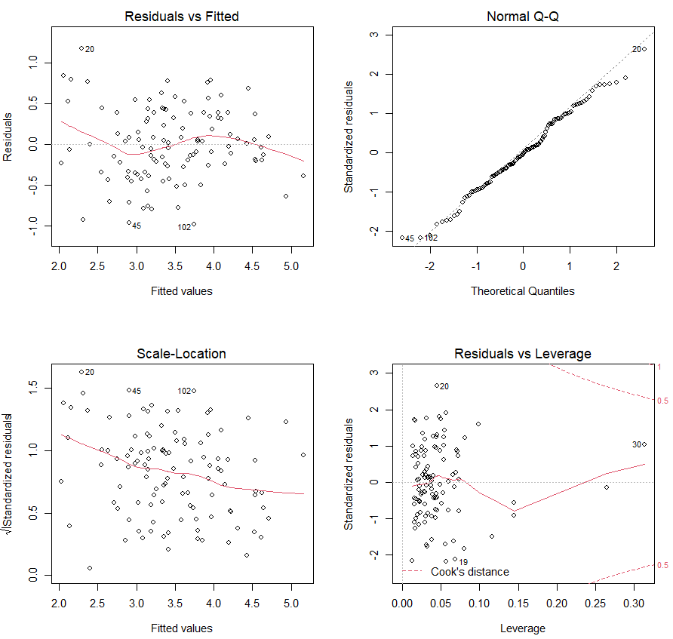
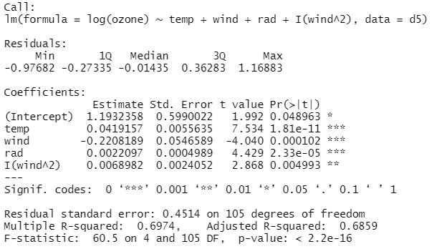
Stepwise deletion approach – model checking
#Remove row 17 and refit the model
d5=d5[-17,]
mod5.9=update(mod5.8,~.)
plot(mod5.9)
#Everything looks great!
summary(mod5.9)
We can now interpret these results:
No minus term: we don’t want to remove anything, we just want to refit the model with the updated dataset
mod5.9

Slide 44
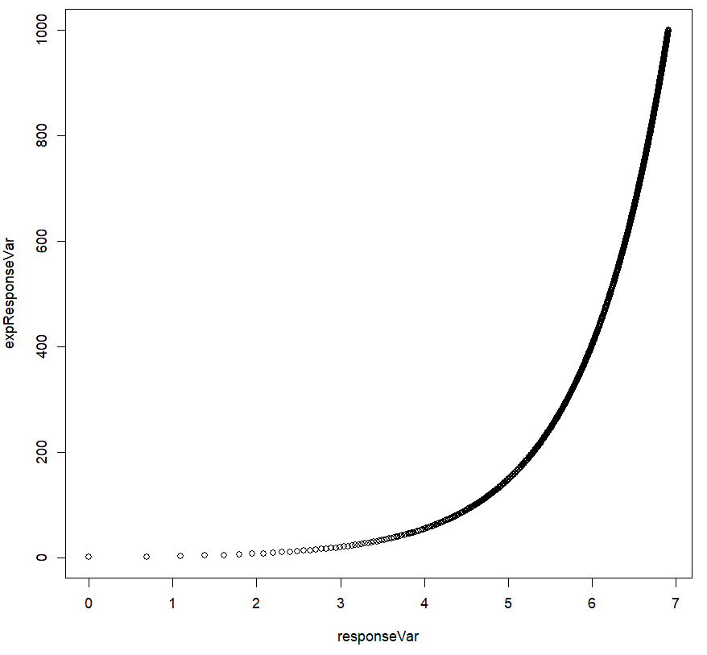
Stepwise deletion approach – interpreting results
A change in the log-transformed variable represents a PERCENTAGE CHANGE in the original variable: we call this kind of relationship “exponential”.
General interpretation:
“Ozone levels increase exponentially with temperature and radiance, and decrease exponentially with wind speed.”
or <temp>
exp(6) = exp(5) x 271%
exp(5) = exp(4) x 271%
exp(4) = exp(3) x 271%
exp(4) = exp(3) x 271%
or log(<temp>)

Slide 45
Stepwise deletion approach – interpreting results
Reporting effect sizes of specific variables:
We have to calculate back from these values. The opposite of log() is exp():
Example with <temp>:
exp(0.0419)=1.042
1.042-1=0.042
“There was a 4.2% increase in ozone levels per unit increase in temperature.”
Example with <wind>:
exp(-0.221)-1=-0.197
“There was a 19.7% decrease in ozone levels per unit increase in wind.”
For <wind>²: The decrease tapers off.
“The negative relationship with wind tapers off at higher wind speeds.”
mod5.9

Slide 46
How to interpret log-transformed variables
For more info, this explains it very well: https://data.library.virginia.edu/interpreting-log-transformations-in-a-linear-model/
Case A—only the response variable is log-transformed
Step 1: Take the exponential, exp(), of the coefficient and minus 1
Step 2: This is the proportional change in the original response variable for every unit change in the explanatory variable
Case B—only the explanatory variable is log-transformed
Step 1: Divide the coefficient by 100
Step 2: A 1% change in the explanatory variable changes the response variable by this amount
Case C—both variables are log-transformed
Step 1: The coefficient is the percentage change in the response variable for every 1% increase in the explanatory variable

Slide 47
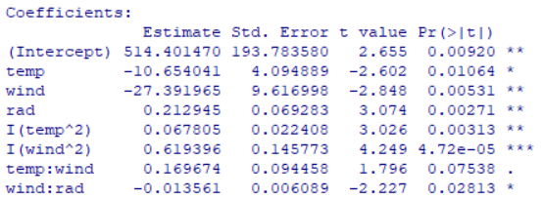
Stepwise deletion approach – a small shortcut
#Can use step() to automate the first few steps of the deletion process
mod5.1s=step(mod5.1)
summary(mod5.1s)
Note: step() has removed all the clearly non-significant variable but kept some marginal ones. It is more lenient than us (which is what we want from an automated procedure). We will then have to continue manually from here.
mod5.1s

Slide 48
Stepwise deletion approach – drawbacks
Potential bias in parameter estimates, especially for variables that are close to significant (to remove or not to remove?)
Potential inconsistencies with model selection algorithms when using automated functions, leading to different results (e.g. different order of parameter deletion)
Multiple hypothesis testing (do we need to correct for it?)
Over-reliance on a single best model (many models may fit the data nearly as well and this uncertainty is not represented).
Potential over-fitting if you start with high-order interaction terms.
Alternative: Information-theoretic approach!

Slide 49
Information-theoretic approach – fitting candidate models
#We first select models that make sense biologically (e.g. based on existing knowledge). Start simple (from the null model) and slowly increase the complexity of the models but base them on theory as much as possible
mod5.11=lm(log(ozone)~1,data=d5) #the Null model
mod5.12=lm(log(ozone)~temp,data=d5)
mod5.13=lm(log(ozone)~wind,data=d5)
mod5.14=lm(log(ozone)~rad,data=d5)
mod5.15=lm(log(ozone)~temp+wind,data=d5)
mod5.16=lm(log(ozone)~wind+rad,data=d5)
mod5.17=lm(log(ozone)~temp+rad,data=d5)
mod5.18=lm(log(ozone)~temp+wind+rad,data=d5)
mod5.19=lm(log(ozone)~temp+wind+rad+I(temp^2),data=d5)
mod5.110=lm(log(ozone)~temp+wind+rad+I(wind^2),data=d5)
mod5.111=lm(log(ozone)~temp+wind+rad+I(temp^2)+I(wind^2),data=d5)

Slide 50
Information-theoretic approach – choosing the best
We then rank the models using a Model Accuracy Metric which measures how well a model can predict data: a LOWER VALUE IS BETTER.
AIC penalises a model for having more predictive variables. Most common.
AICc is a version of the AIC for small sample sizes (n/K < 40; where n is sample size and K is number of parameters).
BIC (Bayesian Information Criterion) has a stronger penalty.
IMPORTANT: you can only use these to compare models when one is a subset of the other.
#We can use the “MuMIn” package to help us do this more quickly
require(MuMIn)
#Create the model.selection object – AIC, AICc or BIC will work
modsAIC=model.sel(mod5.11,mod5.12,mod5.13,mod5.14,mod5.15,mod5.16,mod5.17,mod5.18,mod5.19,mod5.110,mod5.111,rank="AIC")

Slide 51
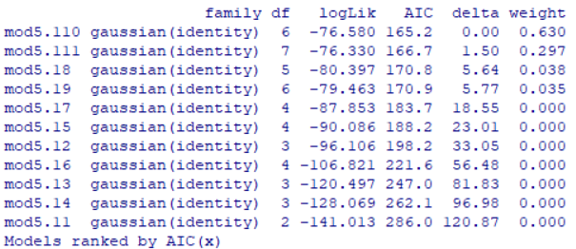
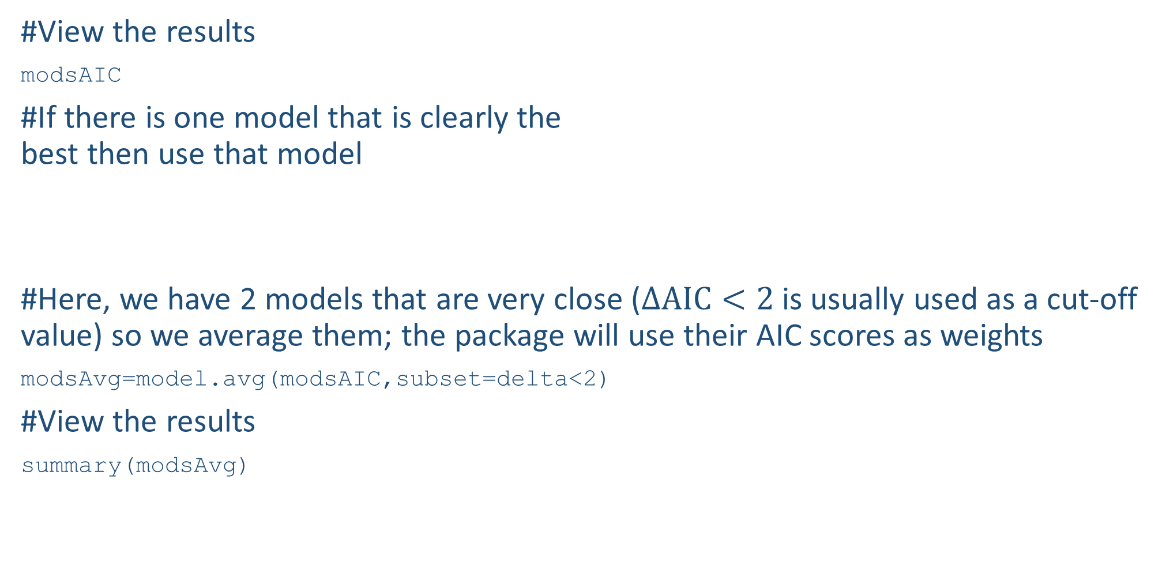
Information-theoretic approach – averaging
#View the results
modsAIC
#If there is one model that is clearly the best then use that model
#Here, we have 2 models that are very close ($Δ\text{AIC}<2$ is usually used as a cut-off value) so we average them; the package will use their AIC scores as weights
modsAvg=model.avg(modsAIC,subset=delta<2)
#View the results
summary(modsAvg)
BEST
WORST

Slide 52

Information-theoretic approach vs. Stepwise deletion approach
The results are very similar.
With the Information-theoretic approach, technically you do not need to simplify further as this has already been taken into account by AIC. However, it’s up to you to make the final decision based on biological intuition.
Information-theoretic (modsAvg)
Stepwise deletion (mod5.9)
Note: Full vs. Conditional Average (Information-theoretic approach)
Full average will input a value of zero for parameters that were not selected in each of the models being averaged. I prefer this.
Conditional will not input any value. Conditional averaging introduces a bias (lower p-value) towards less selected variables.

Slide 53

Multicollinearity – Variance Inflation Factor
Multicollinearity is when two or more explanatory variables are highly correlated.
- This will lead to unstable estimation of model parameters
- Happens quite frequently (e.g. when you measure height and weight) and we sometimes create it ourselves (e.g. creating a new variable by adding 2 existing variables).
To test for it, we measure the Variance Inflation Factor (VIF): if a variable has a VIF value > 3, we remove it.
#Install the “car” package and fit a model with all your explanatory variables modelled individually (i.e. no interactions)
modTest=lm(ozone~temp+wind+rad,data=d5)
vif(modTest) #in this case, everything is OK
If there are variables with VIF > 3, update the model by removing the variable with the highest VIF—either manually fit a new model or use update()—then test this new model using vif(). Repeat this until no more variables have VIF > 3.

Slide 54
What results to present?
A good standard to follow, report at least these 3 things…
1) Sample size (N or n; but usage varies!!)—we usually report this at the start of the Results.
Usage 1: N is population size, n is sample size.
Usage 2: N is total sample size, n is group/level size (this is more useful for ecology).
2) p-value or P (note the italics):
If P ≥ 0.06: report value to 2 decimals (e.g. P = 0.82, P = 0.07).
If 0.001 ≤ P < 0.06: report value to 2 significant figures (e.g. P = 0.0013, 0.053).
If P < 0.001: report “P < 0.001”.
3) Effect size ± confidence intervals:
Mean ± SE
Slope ± 95% Confidence Intervals
Example: “In our experiment (N = 92), the treatment group had noses which were longer than the control group by 2 ± 0.56 cm (mean ± standard error) (P = 0.0043).”
Note: Different journals/companies have different practices.
E.g. Nature also wants the statistic used to calculate the P-value (e.g. t-statistic, F-statistics).
Reported as the analysis results

Slide 55
Summary (Learning Objectives)
Advanced analyses: when to use and Decision tree
Regression
- What is it?
- Important concepts: Maximum Likelihood, slope ($b$), coefficient of determination (r²)
- Types of Regression:
- Linear (OLS) Regression: Assumptions, Power analysis, Fit, Check, Predict
- Robust Regression
- Polynomial Regression
- Multiple Linear Regression: Model simplification, Model comparison, Multicollinearity

